Slide 1

Building Discrete Self Similar Fractals in Seeded TA
Authors: Ryan Knobel, Adrian Salinas, Robert Schweller, Timothy Wylie

Slide 2
Overview
Discrete Self-Similar Fractals
Previous Work
Seeded Tile Automata
Our Construction
Future Work

Slide 3
Discrete Self-Similar Fractals
What are they?

Slide 4
Generator
d
c

Slide 5
Generator
Connected

Slide 6
Generator
Connected
Feasible

Slide 7
Generator
Connected
Feasible

Slide 8
Generator
Connected
Feasible

Slide 9
Generator
Connected
Feasible

Slide 10
Generator
Connected
Feasible

Slide 11
Generator
Connected
Feasible

Slide 12
Generator
Connected
Feasible

Slide 13
Generator
Connected
Feasible

Slide 14
Generator
Connected
Feasible

Slide 15
Generator
Connected
Feasible

Slide 16
Generator
Connected
Feasible

Slide 17
Generator
Connected
Feasible

Slide 18
Generator
Connected
Feasible

Slide 19
Generator
Connected
Feasible
Hamiltonian path

Slide 20
Discrete Self-Similar Fractal
Stage 1

Slide 21
Discrete Self-Similar Fractal
Stage 1

Slide 22
Discrete Self-Similar Fractal
Stage 1

Slide 23
Discrete Self-Similar Fractal
Stage 1

Slide 24
Discrete Self-Similar Fractal
Stage 1

Slide 25
Discrete Self-Similar Fractal
Stage 1

Slide 26
Discrete Self-Similar Fractal
Stage 1

Slide 27
Discrete Self-Similar Fractal
Stage 1
Stage 2

Slide 28
Discrete Self-Similar Fractal

Slide 29
Discrete Self-Similar Fractal
Strict!
Stage 3

Slide 30
Discrete Self-Similar Fractal

Slide 31
Discrete Self-Similar Fractal
Weak!

Slide 32
Previous Work
Why is this important?

Slide 33
DNA Self-Assembly
Tiles:
A
B
C

Slide 34
DNA Self-Assembly
Tiles:
A
A
B
B
C

Slide 35
DNA Self-Assembly
Tiles:
A
A
B
B
C

Slide 36
DNA Self-Assembly
Tiles:
A
A
B
B
C
C

Slide 37
DNA Self-Assembly
Tiles:
A
A
B
C
B
C

Slide 38
DNA Self-Assembly
Tiles:
System:
A
B
C
Affinities:
A
B
C
A
B
B
B
A
C

Slide 39
DNA Self-Assembly
Tiles:
System:
A
B
C
A
Affinities:
A
B
C
A
B
B
B
A
C

Slide 40
DNA Self-Assembly
Tiles:
System:
A
B
C
Affinities:
A
B
A
C
A
B
B
B
A
C

Slide 41
DNA Self-Assembly
Tiles:
System:
A
B
C
Affinities:
A
B
A
C
A
B
B
B
B
A
C

Slide 42
DNA Self-Assembly
Tiles:
System:
A
B
C
Affinities:
A
B
A
B
C
A
B
B
B
A
C

Slide 43
DNA Self-Assembly
Tiles:
System:
A
B
C
Affinities:
A
B
A
B
C
A
B
B
C
B
A
C

Slide 44
DNA Self-Assembly
Tiles:
System:
A
B
C
Affinities:
A
B
A
B
C
C
A
B
B
B
A
C

Slide 45

The aTAM (abstract Tile Assembly Model)
Tiles:
System:
A
B
C
Affinities:
A
B
A
B
Temperature: $τ$
C
C
A
B
B
B
A
C

Slide 46
The aTAM (abstract Tile Assembly Model)
Tiles:
System:
A
B
C
A
Affinities:
A
B
A
B
Temperature: $τ$
C
C
A
B
B
C
B
A
C
B

Slide 47
The aTAM (abstract Tile Assembly Model)
Tiles:
System:
A
B
C
Affinities:
A
B
A
B
A
B
Temperature: $τ$
C
C
C
A
B
B
B
A
C

Slide 48
The aTAM (abstract Tile Assembly Model)
Tiles:
System:
A
B
C
Affinities:
A
B
A
B
A
B
A
B
A
B
A
B
A
Temperature: $τ$
C
C
C
C
C
C
A
B
B
B
A
C

Slide 49
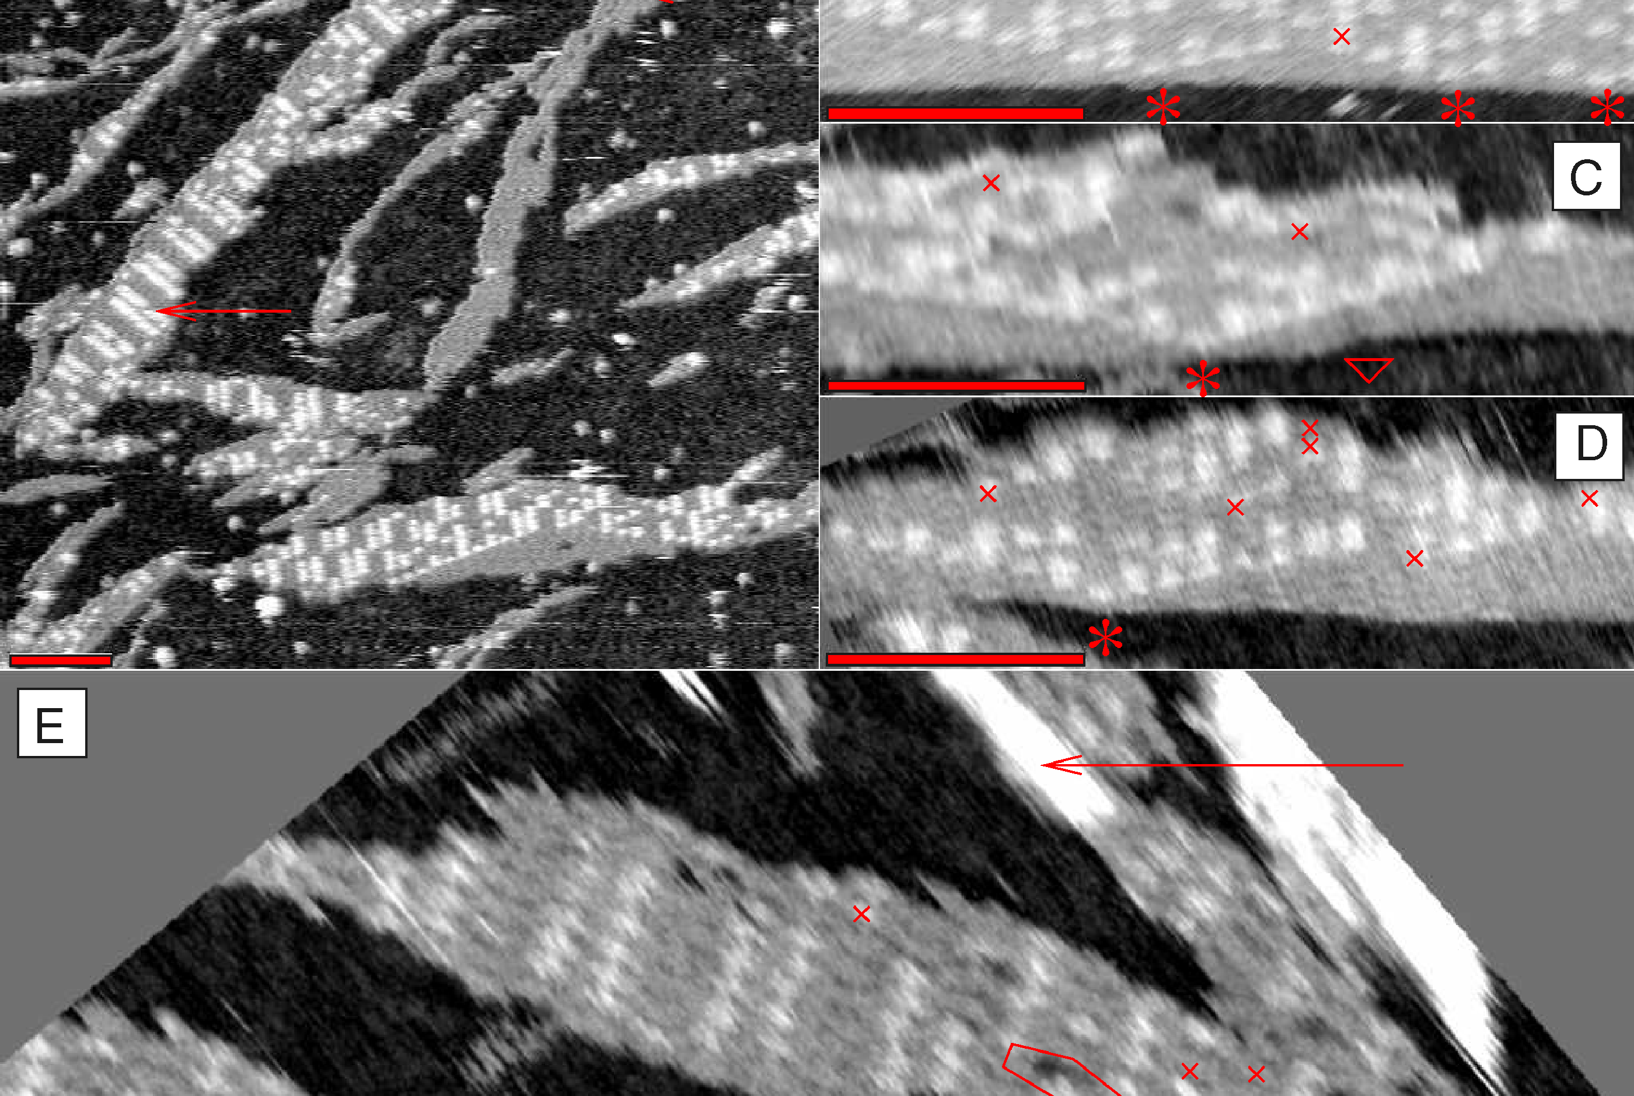
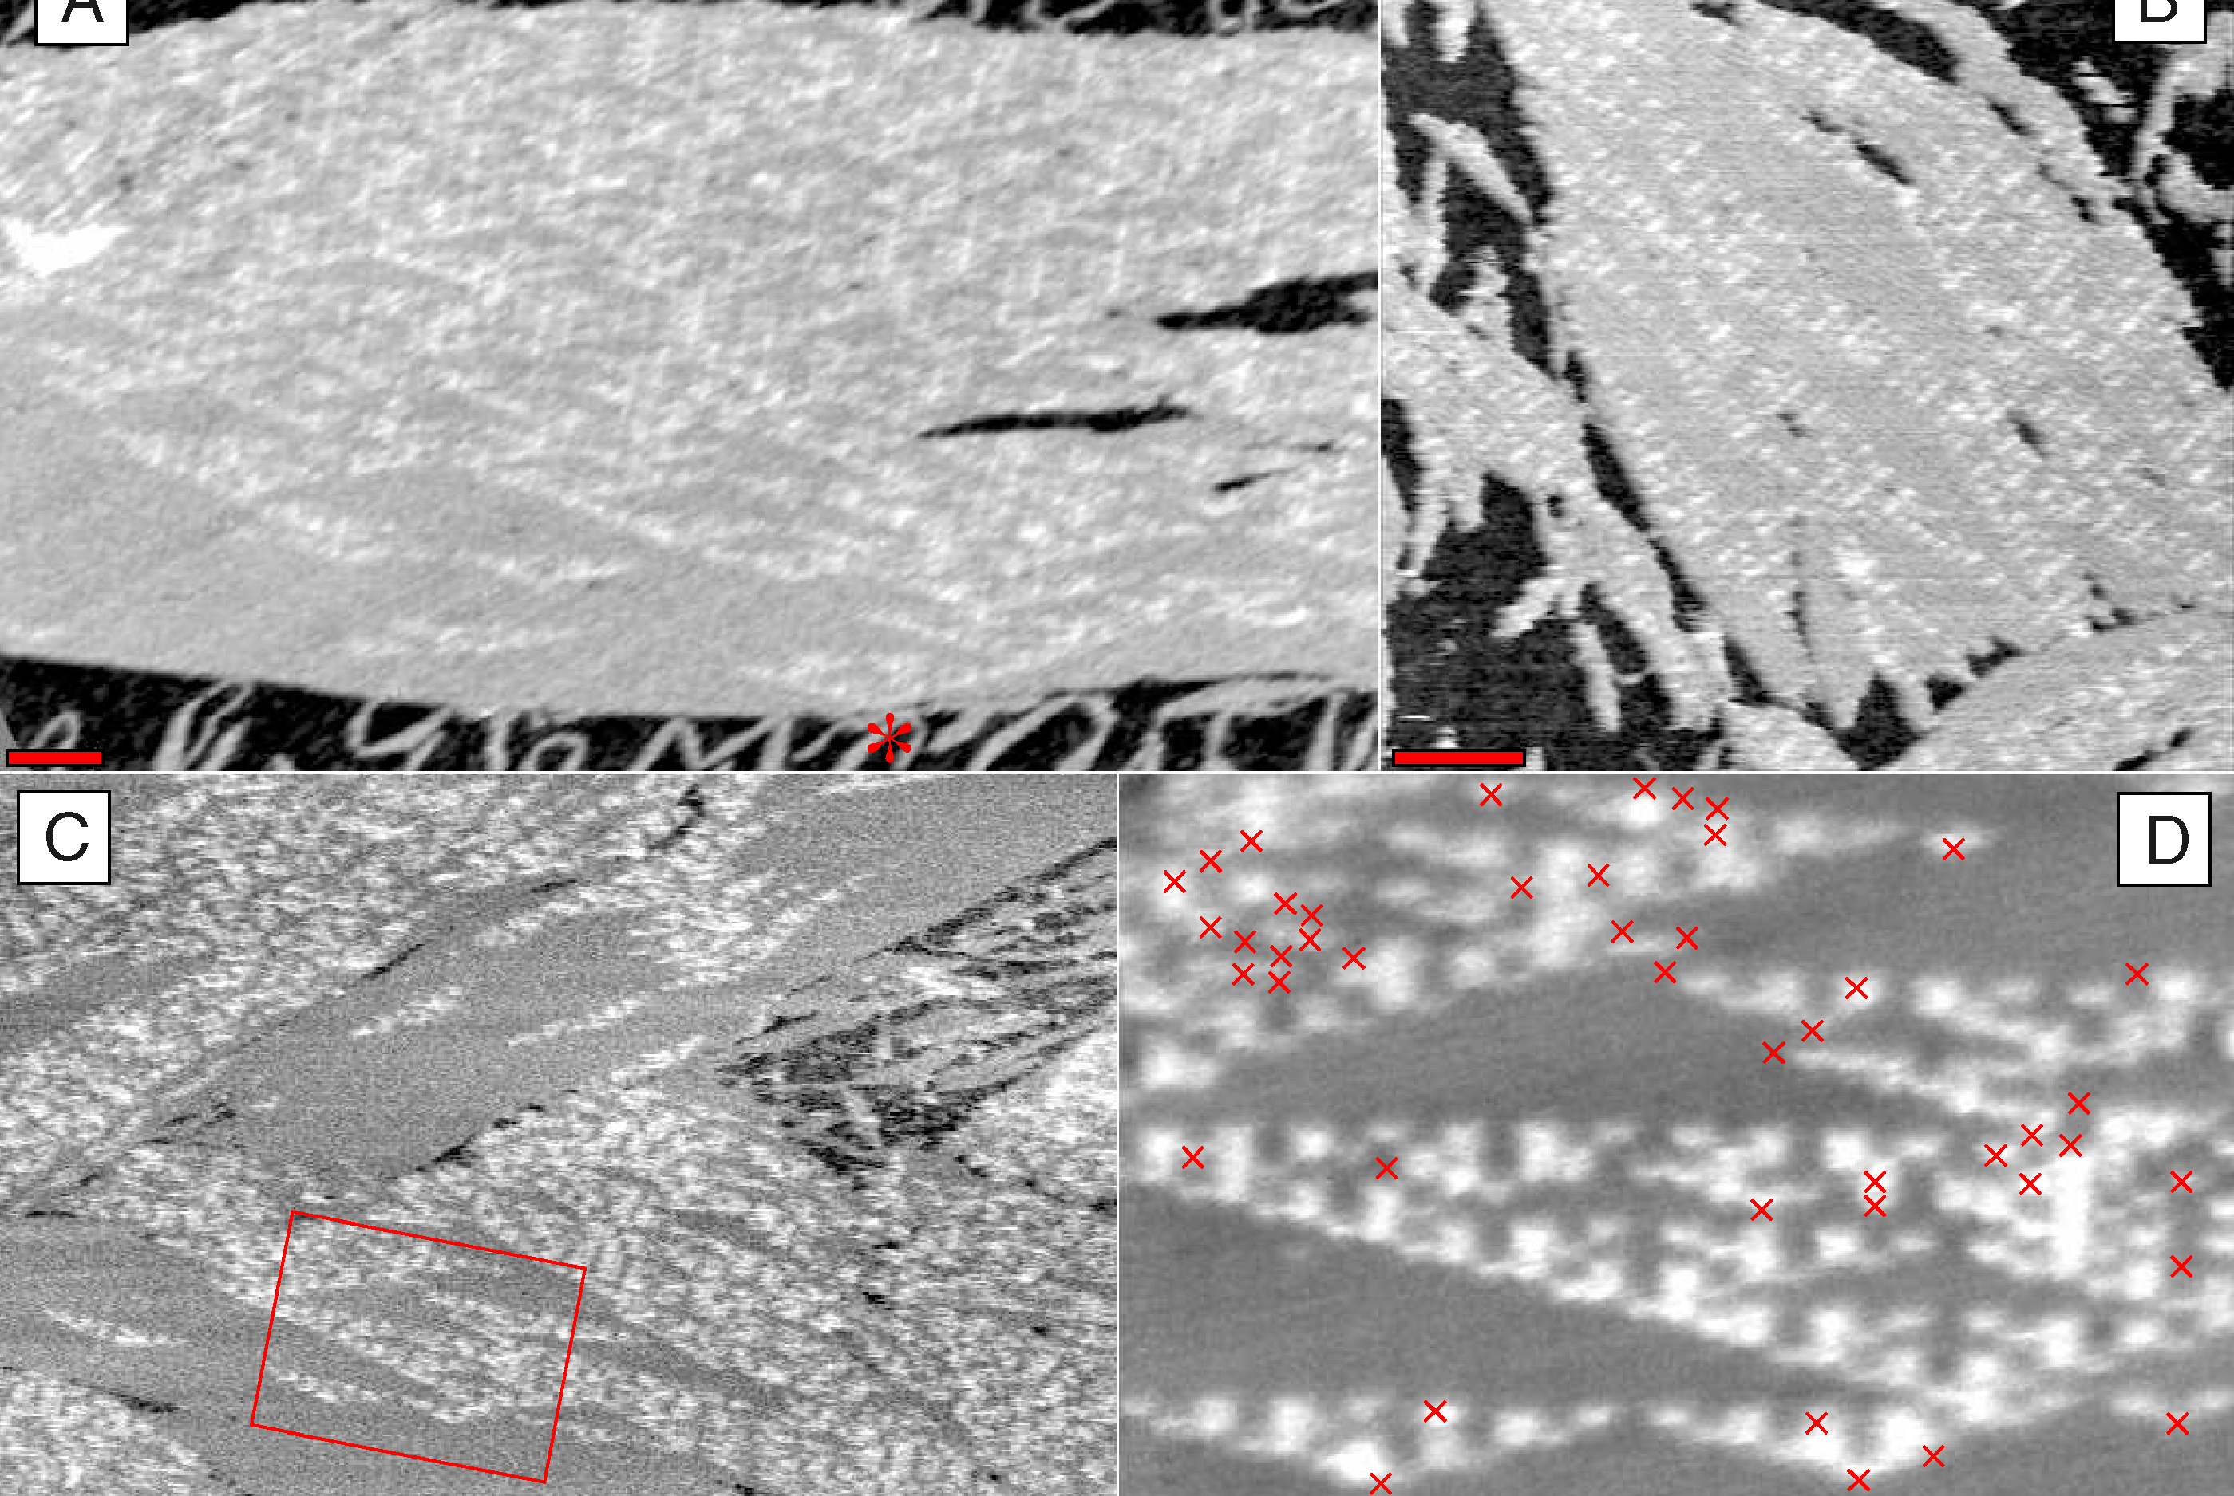
What is known (aTAM)
Rothemund PWK, Papadakis N, Winfree E (2004) Algorithmic Self-Assembly of DNA Sierpinski Triangles. PLoS Biol 2(12): e424.

Slide 50
What is known (aTAM)
2010:
  Any “L” shape does not strictly self assemble in the aTAM (any temp)
  No fractal weakly self assembles at temperature 1
  “Nice” fractals can be weakly self assembled at higher temps
2020:
  The “H” and “U” shapes do not strictly self assemble in the aTAM

Slide 51
Variations of the aTAM
2HAM (2-Handed Assembly Model):
  2 different assemblies can attach

Slide 52
The 2HAM (2-Handed Assembly Model)
System:
A
B
A
B
A
B
A
C
C
C
A
B
A
B
A
B
C
C
C

Slide 53
The 2HAM (2-Handed Assembly Model)
System:
A
B
A
B
A
B
A
B
A
B
A
B
A
C
C
C
C
C
C

Slide 54
Variations of the aTAM
2HAM (2-Handed Assembly Model):
  2 different assemblies can attach
  Can finitely assemble a larger class of shapes
STAM (Signal-Passing Tile Assembly Model):
  Glues can turn “on” and “off”
  Detachment is allowed

Slide 55
The STAM (Signal-Passing Tile Assembly Model)
System:
A
B
A
B
A
B
A
B
A
B
A
B
A
C
C
C
C
C
C

Slide 56
The STAM (Signal-Passing Tile Assembly Model)
System:
A
B
A
B
A
B
A
B
A
C
C
C
C
A
B
A
B
C
C

Slide 57
Variations of the aTAM
2HAM (2-Handed Assembly Model):
  2 different assemblies can attach
  Can finitely assemble a larger class of shapes
STAM (Signal-Passing Tile Assembly Model):
  Glues can turn “on” and “off”
  Detachment is allowed
  Any arbitrary fractal is buildable
  Without detachments, some shapes impossible

Slide 58
A Comparison
 | aTAM | 2HAM | STAM
Description | Single tile attachments No detachments Fixed glues | Up to 2 assembly attachments No detachments Fixed glues | Up to 2 assembly attachments Detachments Glues turn on/off
Results | No fractals weakly buildable (temp 1) Some fractals not strictly buildable (temp > 1) | Finitely assemble larger class of shapes Still some non-buildable fractals | All fractals strictly buildable Without detachment: some impossible fractals
Question: What if adjacent tiles can infinitely change states?

Slide 59
Seeded Tile Automata
What is the model?

Slide 60
Seeded TA
Tiles:
System:
A
A
B
C
B
A
Affinities:
A
A
Temperature: $τ$
C
B
B
B
A
B
B
B
A
C
B
C
A

Slide 61
Seeded TA
Tiles:
System:
A
A
B
C
B
A
Affinities:
A
A
Temperature: $τ$
C
B
B
B
A
B
B
C
B
A
C
B
A

Slide 62
Seeded TA
Tiles:
System:
A
A
B
C
B
A
Affinities:
A
A
Temperature: $τ$
B
B
B
A
B
B
C
C
B
A
C
B
A

Slide 63
Seeded TA
Tiles:
System:
A
A
B
C
B
A
Affinities:
A
A
Temperature: $τ$
B
B
B
A
A
B
B
C
C
B
A
C
B

Slide 64
Seeded TA
Tiles:
System:
A
B
C
Affinities:
A
A
B
A
B
Temperature: $τ$
B
B
A
B
A
A
B
B
C
C
B
A
C

Slide 65
Seeded TA
Transitions:
System:
A
B
C
C
Affinities:
A
A
B
A
B
Temperature: $τ$
B
B
A
B
A
A
B
B
C
C
B
A
C

Slide 66
Seeded TA
Transitions:
System:
A
B
C
C
Affinities:
A
C
C
A
B
Temperature: $τ$
B
B
A
B
A
A
B
B
C
C
B
A
C

Slide 67
Seeded TA
Transitions:
System:
A
B
C
C
Affinities:
A
C
C
A
B
Temperature: $τ$
B
B
C
C
A
A
B
B
C
C
B
A
C

Slide 68
Seeded TA
Transitions:
System:
A
B
C
C
Affinities:
A
C
C
C
C
Temperature: $τ$
B
B
C
C
A
A
B
B
C
C
B
A
C

Slide 69
Our Contribution
 | aTAM | 2HAM | STAM | Seeded TA
Description | Single tile attachments No detachments Fixed glues | Up to 2 assembly attachments No detachments Fixed glues | Up to 2 assembly attachments Detachments Glues turn on/off | Single tile attachments No detachments Transitions
Results | No fractals weakly buildable (temp 1) Some fractals not strictly buildable (temp > 1) | Finitely assemble larger class of shapes Still some non-buildable fractals | All fractals strictly buildable Without detachment: some impossible fractals | Fractals with generators that have a Ham-path are strictly buildable (temp 1)

Slide 70
The Construction
How did we do it?

Slide 71
High Level Idea

Slide 72
High Level Idea

Slide 73
High Level Idea

Slide 74
High Level Idea

Slide 75
High Level Idea

Slide 76
High Level Idea

Slide 77
High Level Idea

Slide 78
High Level Idea

Slide 79
High Level Idea

Slide 80
High Level Idea

Slide 81
Local Information
State of tile

Slide 82
Local Information
State of tile

Slide 83
Local Information
State of tile
- Producing

Slide 84
Local Information
State of tile
- Producing
- Waiting

Slide 85
Local Information
State of tile
- Producing
- Waiting
- Finished

Slide 86
Local Information
State of tile
Info from neighbors

Slide 87
Local Information
State of tile
Info from neighbors
- Who are they?
- State?
- Tile being placed?

Slide 88
Local Information
State of tile
Info from neighbors
- Who are they?
- State?
- Tile being placed?

Slide 89
Local Information
State of tile
Info from neighbors
- Who are they?
- State?
- Tile being placed?

Slide 90
Local Information
State of tile
Info from neighbors
- Who are they?
- State?
- Tile being placed?

Slide 91
Local Information
State of tile
Info from neighbors
- Who are they?
- State?
- Tile being placed?

Slide 92
Local Information
State of tile
Info from neighbors
- Who are they?
- State?
- Tile being placed?

Slide 93
Local Information
State of tile
Info from neighbors
Direction to send signal

Slide 94
Local Information
State of tile
Info from neighbors
Direction to send signal

Slide 95
Local Information
State of tile
Info from neighbors
Direction to send signal

Slide 96
Local Information
State of tile
Info from neighbors
Direction to send signal

Slide 97
Local Information
State of tile
Info from neighbors
Direction to send signal

Slide 98
Local Information
State of tile
Info from neighbors
Direction to send signal

Slide 99
Local Information
State of tile
Info from neighbors
Direction to send signal

Slide 100
Local Information
State of tile
Info from neighbors
Direction to send signal

Slide 101
Local Information
State of tile
Info from neighbors
Direction to send signal

Slide 102
Local Information
State of tile
Info from neighbors
Direction to send signal
Step

Slide 103
Local Information
State of tile
Info from neighbors
Direction to send signal
Step
0
1
0
0
1
1

Slide 104
Local Information
State of tile
Info from neighbors
Direction to send signal
Step
0
1
0
0
1
1

Slide 105
Local Information
State of tile
Info from neighbors
Direction to send signal
Step
0
1
0
0
1
1

Slide 106
Local Information
State of tile
Info from neighbors
Direction to send signal
Step
Terminal?

Slide 107
Local Information
State of tile
Info from neighbors
Direction to send signal
Step
Terminal?

Slide 108
The Process
First tile places itself

Slide 109
The Process
First tile places itself

Slide 110
The Process
First tile places itself

Slide 111
The Process
First tile places itself
Next tile is chosen, repeats

Slide 112
The Process
First tile places itself
Next tile is chosen, repeats

Slide 113
The Process
First tile places itself
Next tile is chosen, repeats

Slide 114
The Process
First tile places itself
Next tile is chosen, repeats
If terminal, a cap is placed

Slide 115
The Process
First tile places itself
Next tile is chosen, repeats
If terminal, a cap is placed

Slide 116
The Process
First tile places itself
Next tile is chosen, repeats
If terminal, a cap is placed

Slide 117
The Process
First tile places itself
Next tile is chosen, repeats
If terminal, a cap is placed

Slide 118
The Process
First tile places itself
Next tile is chosen, repeats
If terminal, a cap is placed

Slide 119
The Process
First tile places itself
Next tile is chosen, repeats
If terminal, a cap is placed
Shift caps if needed

Slide 120
The Process
First tile places itself
Next tile is chosen, repeats
If terminal, a cap is placed
Shift caps if needed

Slide 121
The Process
First tile places itself
Next tile is chosen, repeats
If terminal, a cap is placed
Shift caps if needed

Slide 122
The Process
First tile places itself
Next tile is chosen, repeats
If terminal, a cap is placed
Shift caps if needed
Reset when complete

Slide 123
The Process
First tile places itself
Next tile is chosen, repeats
If terminal, a cap is placed
Shift caps if needed
Reset when complete

Slide 124
Final Result (Sierpinski Triangle)

Slide 125
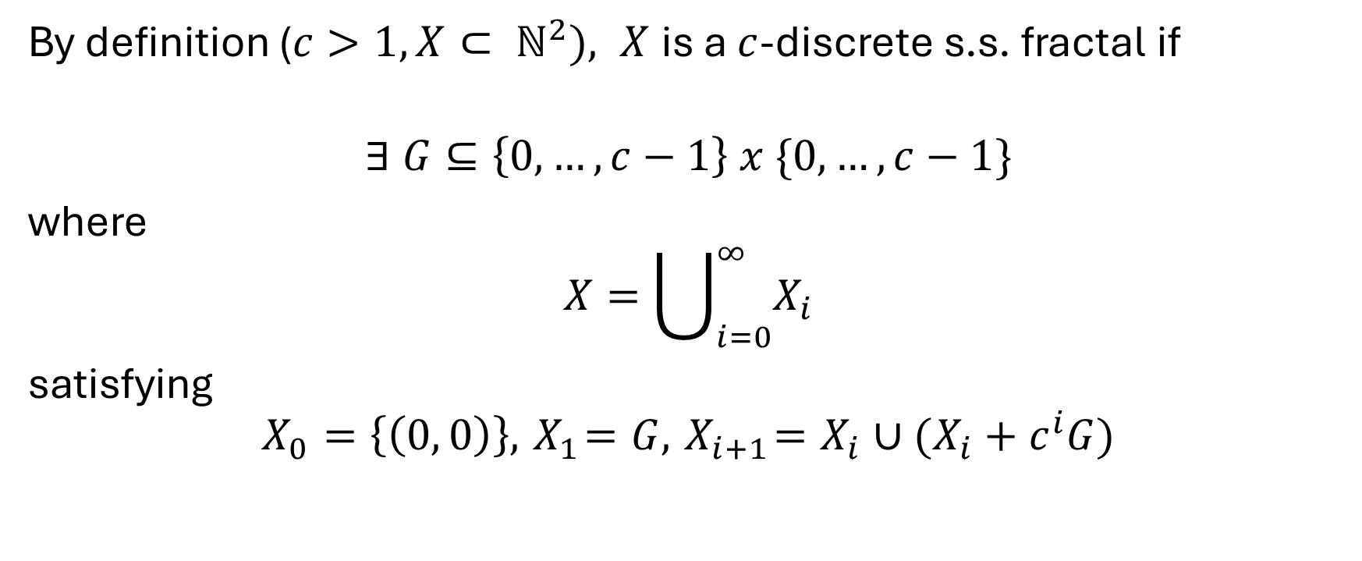
Brief Proof Sketch
By definition ($c>1, X⊂ ℕ^{2}), X$ is a $c$-discrete s.s. fractal if
$$∃ G⊆\left\{0, …, c−1\right\} x \{0, …, c−1\}$$
where
$$X=\bigcup_{i=0}^{∞}{X_{i}}$$
satisfying
$$X_{0}=\left\{\left(0, 0\right)\right\}, { X}_{1}=G, { X}_{i+1}=X_{i}∪({X_{i}+c}^{i}G)$$

Slide 126



Brief Proof Sketch
$$X_{1}=G$$
$$X_{2}$$
$$X_{3}$$
Our construction follows this!

Slide 127
Future Work
What is left?

Slide 128
Future Work
Does this extend to ALL generators?

Slide 129
Future Work

Slide 130
Future Work

Slide 131
Future Work

Slide 132
Future Work

Slide 133
Future Work

Slide 134
Future Work

Slide 135
Future Work

Slide 136
Future Work

Slide 137
Future Work

Slide 138
Future Work

Slide 139
Future Work

Slide 140
Future Work
Does this extend to ALL generators?
Does there exist more efficient methods?
  Linear in size of generator
  Implement a counter encoded in the fractal?
Are there any provable lower bounds?
Does there exist a SINGLE system that can strictly build any fractal with any arbitrary generator?

